Slide 1
Deploying WebLogic Applications on Kubernetes
David Yang
Cloud Platform Team, Taiwan

Slide 3

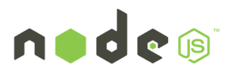




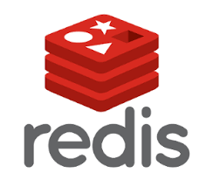

Oracle Enterprise Java Strategy Evolve Products to Meet Customer Demand
WebLogic Kubernetes on OCI and other Clouds
Migrate to Kubernetes on premise
Tools for migration and management
Support existing and new applications
Migrate to Kubernetes on Oracle Cloud
Leverage management tools on OCI
Availability, security, scaling, low-cost
Integrate with Microservices
Flexibility for developers
Evolve and manage applications
Operator
WebLogic
Coherence
WebLogic
Migrate
Migrate
Operator
WebLogic Kubernetes on Premise
WebLogic
Coherence
Helidon
Migrate
WebLogic on Premise

Slide 4




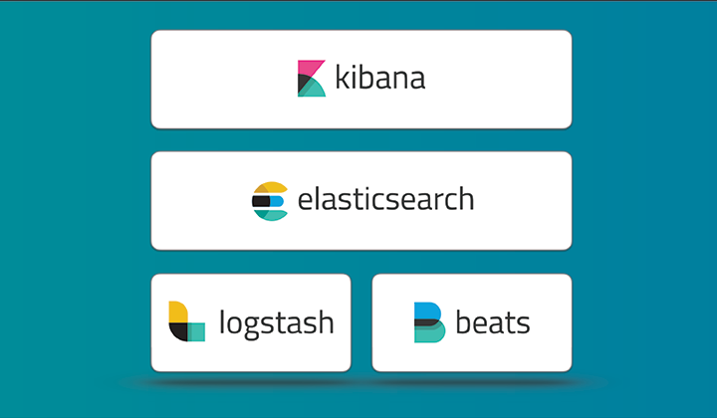
WebLogic Server on Kubernetes - Building Blocks
Operator
Docker and CRI-O certification
Docker images, Dockerfiles, examples
WebLogic Kubernetes certification
How-to, best practices
Value add integration
Management: Operator
Monitoring: Exporter for Prometheus
Migration: Deploy tooling
Logging: Exporter for Elastic Stack
Image Creation: WebLogic Image Tool
WebLogic
Coherence

Slide 5





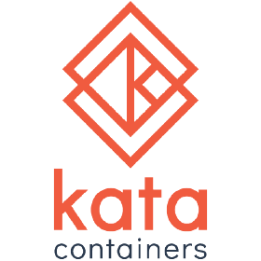

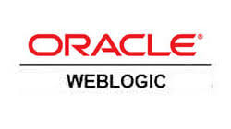




Improved DevOps for Traditional Applications
Automate for Productivity and Time to Value
Monitor, Update, Patch, Extend
Develop
Build
Package
Deploy/
Monitor/Scale
Operators
EE

Slide 6
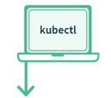



Why build the WebLogic Kubernetes Operator?
Contains built-in knowledge about how to perform lifecycle operations on a domain
Uses Kubernetes APIs to automate lifecycle operations.
Operator
Kubernetes
Orchestrate WebLogic
Manage
Pods
WLS Cluster
POD 1
POD 2
POD 3
POD 4
POD 5
POD 6
AS
MS
MS
MS
MS
MS
Kubernetes Cluster
Notes:
Operator is an application-specific controller that extends Kubernetes to create, configure, and manage instances of complex applications. The WebLogic Kubernetes Operator follows the standard Kubernetes Operator pattern,
Some of the things that the Operator does to simplify management and operations on the WebLogic domain and deployments
Create RBAC roles to manage Kubernetes resources on behalf of the WebLogic domain. Authorization to start/stop/restart/create new domain.
Invokes the right Kubernetes APIs to start or stop servers, domains, clusters
the WebLogic Diagnostic framework Auto-scale setting rules in when the rule is met the Operator will invoke K8S API to scale the WebLogic cluster
When there is a new patched WebLogic image or a Application update initiate a rolling restart of the WebLogic domain

Slide 7
WebLogic Kubernetes Operator
1
2
3
Manages lifecycle operations (start, stop, scale, rolling restart, etc.) in Kubernetes
Automate configuration, e.g. clustering, channels/ports, configuration overrides
Supports standard k8s idioms like sidecars, init containers, custom resources
Open source and fully supported https://github.com/oracle/weblogic-kubernetes-operator

Slide 8
Deploy WebLogic Server in Kubernetes

Slide 9

WebLogic Server Domain in Kubernetes
Customer Tenancy
Repository
WLS Domain Image
Operator
Image
Kubernetes
Secrets
Domain CR
WebLogic Domain Image
WebLogic binaries
Domain
Applications
Operator
WebLogic Domain(s)
WLS Cluster
POD 1
POD 2
POD 3
POD 4
POD 5
POD 6
AS
MS
MS
MS
MS
MS
Logs

Slide 10
WebLogic Domain in Kubernetes Domain Customer Resource
We create a Kubernetes Resource Object for the WebLogic domain.
This is a data structure representation of the WebLogic domain in Kubernetes.
Domain Custom Resource allows you to declare or specify the desired state of the resource.
Allows the Kubernetes API server to begin serving the custom resource object.
The WebLogic Kubernetes Operator is a controller that is always looking at the Domain Custom Resource and tries to match the actual state to this desired state.
Domain Custom Resource
Meta Data: Name of Resource, Namespace, Labels, …
Admin Server: Node Ports to expose, Volumes, …
Cluster: Number of Replicas (Managed Servers), …
Domain: Image to base the Domain containers, Domain in PV or in Image, K8S secrets, Logs to pod
Managed Servers: non-clustered MS
Server Pod: Java Options, Start Policy (Lifecycle control)
Events:

Slide 11


WebLogic Domain in Kubernetes Operator
Domain Home in Image
Customer Tenancy
Repository
WLS Domain Image
Operator
Image
Kubernetes
Kubernetes
Kubernetes Cluster
Kubernetes

Slide 12
WebLogic Domain in Kubernetes Operator
Customer Tenancy
Repository
WLS Domain Image
Operator
Image
Kubernetes
Kubernetes
Kubernetes Cluster
Secrets
Kubernetes

Slide 13

WebLogic Domain in Kubernetes Operator
Customer Tenancy
Repository
WLS Domain Image
Operator
Image
Kubernetes
Kubernetes
Kubernetes Cluster
Secrets
Operator
Kubernetes

Slide 14
WebLogic Domain in Kubernetes Operator
Customer Tenancy
Repository
WLS Domain Image
Operator
Image
Kubernetes
Kubernetes
Kubernetes Cluster
Secrets
Operator
Kubernetes

Slide 15
WebLogic Domain in Kubernetes Operator
Customer Tenancy
Repository
WLS Domain Image
Operator
Image
Kubernetes
Kubernetes
Kubernetes Cluster
Secrets
Operator
Kubernetes

Slide 16
WebLogic Domain in Kubernetes Operator
Customer Tenancy
Repository
WLS Domain Image
Operator
Image
Kubernetes
Kubernetes
Kubernetes Cluster
Secrets
Operator
Install Domain inputs (yaml)
Kubernetes

Slide 17
WebLogic Domain in Kubernetes Operator
Customer Tenancy
Repository
WLS Domain Image
Operator
Image
Kubernetes
Kubernetes
Domain CR
Kubernetes Cluster
Secrets
Operator
Install Domain inputs (yaml)
kubectl apply …
Kubernetes

Slide 18
WebLogic Domain in Kubernetes Operator
Customer Tenancy
Repository
WLS Domain Image
Operator
Image
Kubernetes
Kubernetes
Domain CR
Kubernetes Cluster
Secrets
Operator
WebLogic Domain(s)
WLS Cluster
POD 1
POD 2
POD 3
POD 4
POD 5
POD 6
AS
MS
MS
MS
MS
MS
Kubernetes
Logs

Slide 19
WebLogic Server Domain in Kubernetes
Repository
Customer Tenancy
WLS Domain Image
Operator
Image
Kubernetes
Secrets
Domain CR
WebLogic install Image
WebLogic binaries
PV
Domain
Applications
Operator
WebLogic Domain(s)
WLS Cluster
POD 1
POD 2
POD 3
POD 4
POD 5
POD 6
AS
MS
MS
MS
MS
MS
Logs
Domain
Application

Slide 20
Which model should I use?
The key difference is how updates are handled
Java updates
WebLogic patching
WebLogic configuration changes
Application updates
Are you fully embracing the CI/CD "DevOps" model and intend to manage change through that process?
e.g. create new images every time there is an update.
Are you making changes to configurations and deployments in running systems?
e.g. run WLST online to dynamically change your domain configuration.

Slide 21
Configuration Overrides

Slide 22
Configuration Overrides
WebLogic Images containing Application, domain configuration, resources are immutable
These Docker images must be portable
Development -> Testing -> Production
Follow the customer’s CI/CD process
Therefore, customers need a mechanism to override certain domain configuration
e.g. Provide data source URL and credentials

Slide 23
Domain Introspection and Config Override Generation
Introspection Job
WLS Domain Image
Domain
Customer provided override templates
Scan domain configuration for topology and to validate
Generation of final configuration overrides
Operator
Operator overrides

Slide 24
User Configuration Overrides
Typical attributes for overrides include:
User names, passwords, and URLs for:
JDBC datasources
JMS bridges, foreign servers, and SAF
Network channel public addresses:
For remote RMI clients (T3, JMS, EJB, JTA)
For remote WLST clients
Debugging
Tuning (MaxMessageSize, etc.)

Slide 25
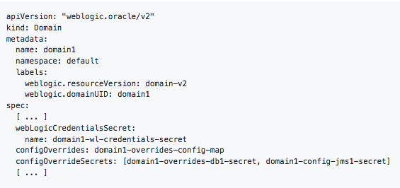
Configuration Overrides
Create a Kubernetes configuration map that contains:
Override templates
Create Kubernetes secrets that contains:
Data source username and password.
Set your domain CR
Config map.
Secret with the Config Override
Start or restart your domain.

Slide 26
Life Cycle Operations

Slide 27
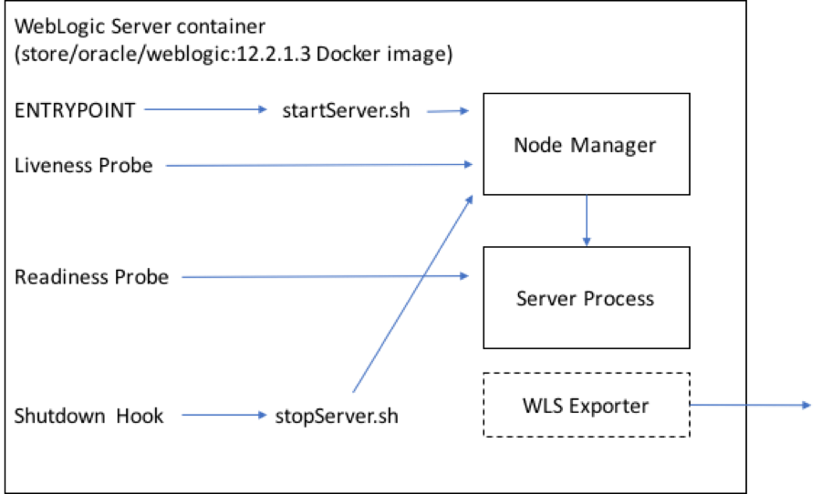
WebLogic Operator Lifecycle Management
ENTRYPOINT – start WebLogic Server
Liveliness probe – check if the the WebLogic server is alive
Readiness probe – query if the WebLogic server is ready to receive requests
Shutdown Hook – gracefully shutdown the WebLogic server

Slide 28
WebLogic Lifecycle Management
The operator automatically recreates server pods when :
Changes to the Domain CR that affect server pods (image, volumes, and env).
A user can control lifecycle of the WebLogic domain/cluster/server by editing Domain Custom Resource
Start/stop/re-start
initiate a rolling-restart of the domain.
The Operator reacts and performs the correct lifecycle operation.
Stop Clustered Manage Server 1
Edit Domain CR
Domain Custom Resource
domain:
spec:
managedServers:
- serverName: "cluster1_server1”
serverStartPolicy: ”NEVER" ...

Slide 29
Assigning Pods to Nodes

Slide 30
Assigning WebLogic Pods to Nodes
Use Node Selector to constrain a pod to only be able to run on particular nodes.
Assign a label (key=value)to the node:
kubectl label nodes kubernetes-foo-node-1 licensed-for-weblogic=true
Edit the Domain Custom Resource at the domain/cluster/server level and assign key:value nodeSelector.
Edit Domain CR
Domain Custom Resource
serverPod:
nodeSelector:
licensed-for-weblogic: true

Slide 31
Assigning WebLogic Pods to Nodes
Assign pods to Nodes based on resources, e.g. CPU and Memory usage
A Pod is scheduled to run on a Node only if the Node has enough CPU resources available.
Edit Domain CR
Domain Custom Resource
serverPod:
resources:
requests:
memory: "8Gb"
cpu: "250m"
limits:
memory: "128Mi"
cpu: "500m"`

Slide 32
WLS POD2
Operator
Schedule
Node 1
Node 2
Node 3
WLS POD1
weblogic.clusterName
Licensed-for-weblogic
Licensed-for-weblogic
nodeSelector:
licensed-for-weblogic: true
affinity: podAntiAffinity:
preferredDuringSchedulingIgnoredDuringExecution:
- labelSelector:
matchExpressions:
- key: "weblogic.clusterName"
- operator: In

Slide 33
Operator
Node 1
Node 2
Node 3
WLS POD1
WLS POD2
weblogic.clusterName
weblogic.clusterName
Licensed-for-weblogic
Licensed-for-weblogic
nodeSelector:
licensed-for-weblogic: true
affinity: podAntiAffinity:
preferredDuringSchedulingIgnoredDuringExecution:
- labelSelector:
matchExpressions:
- key: "weblogic.clusterName"
- operator: In

Slide 34
WLS POD3
Operator
Schedule
Node 1
Node 2
Node 3
WLS POD1
WLS POD2
weblogic.clusterName
weblogic.clusterName
Licensed-for-weblogic
Licensed-for-weblogic
nodeSelector:
licensed-for-weblogic: true
affinity: podAntiAffinity:
preferredDuringSchedulingIgnoredDuringExecution:
- labelSelector:
matchExpressions:
- key: "weblogic.clusterName"
- operator: In

Slide 35
Operator
Node 1
Node 2
Node 3
WLS POD1
WLS POD3
WLS POD2
weblogic.clusterName
weblogic.clusterName
weblogic.clusterName
Licensed-for-weblogic
Licensed-for-weblogic
nodeSelector:
licensed-for-weblogic: true
affinity: podAntiAffinity:
preferredDuringSchedulingIgnoredDuringExecution:
- labelSelector:
matchExpressions:
- key: "weblogic.clusterName"
- operator: In

Slide 36
Init Containers and Sidecar Containers

Slide 37
Init Containers
Repository
Customer Tenancy
WLS Domain Image
Init containers run in the same pod as the WebLogic servers
Init containers can be used to perform some initialization action before the server is started
Example: Change permissions in PV before the domain home is persisted
Operator
Image
Kubernetes
Kubernetes
Domain CR
Secrets
Operator
WebLogic Domain(s)
POD 1
WLS Cluster
POD 2
POD 3
POD 4
POD 5
POD 6
Init
AS
Init
MS
Init
MS
Init
MS
MS
MS
MS
Change permissions of directory
Logs
Domain
Application

Slide 38
Sidecar Containers
Repository
Customer Tenancy
WLS Domain Image
Sidecar containers run in the same pod as the WebLogic servers
Sidecar containers can be used to run some process aside the server
Example: Run Logstash or Fluentd in Sidecar to send logs to the Elastic Stack or to Fluentd
Operator
Image
Kubernetes
Domain CR
Kubernetes
Secrets
Operator
WebLogic Domain(s)
POD 1
WLS Cluster
POD 2
POD 3
POD 4
POD 5
POD 6
SC
AS
SC
MS
SC
MS
SC
MS
MS
MS
MS
Change permissions of directory
Logs

Slide 39
CI/CD

Slide 40
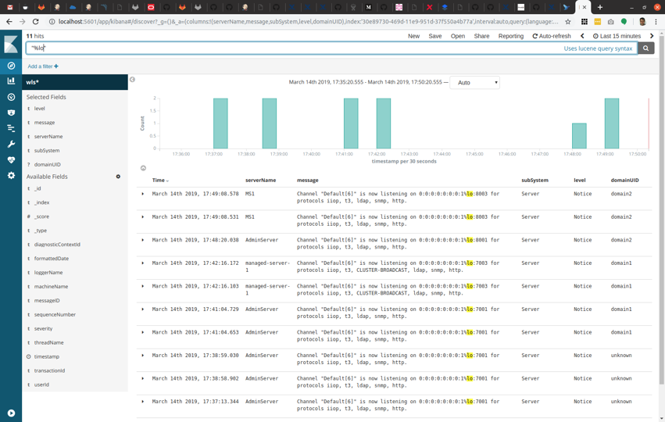
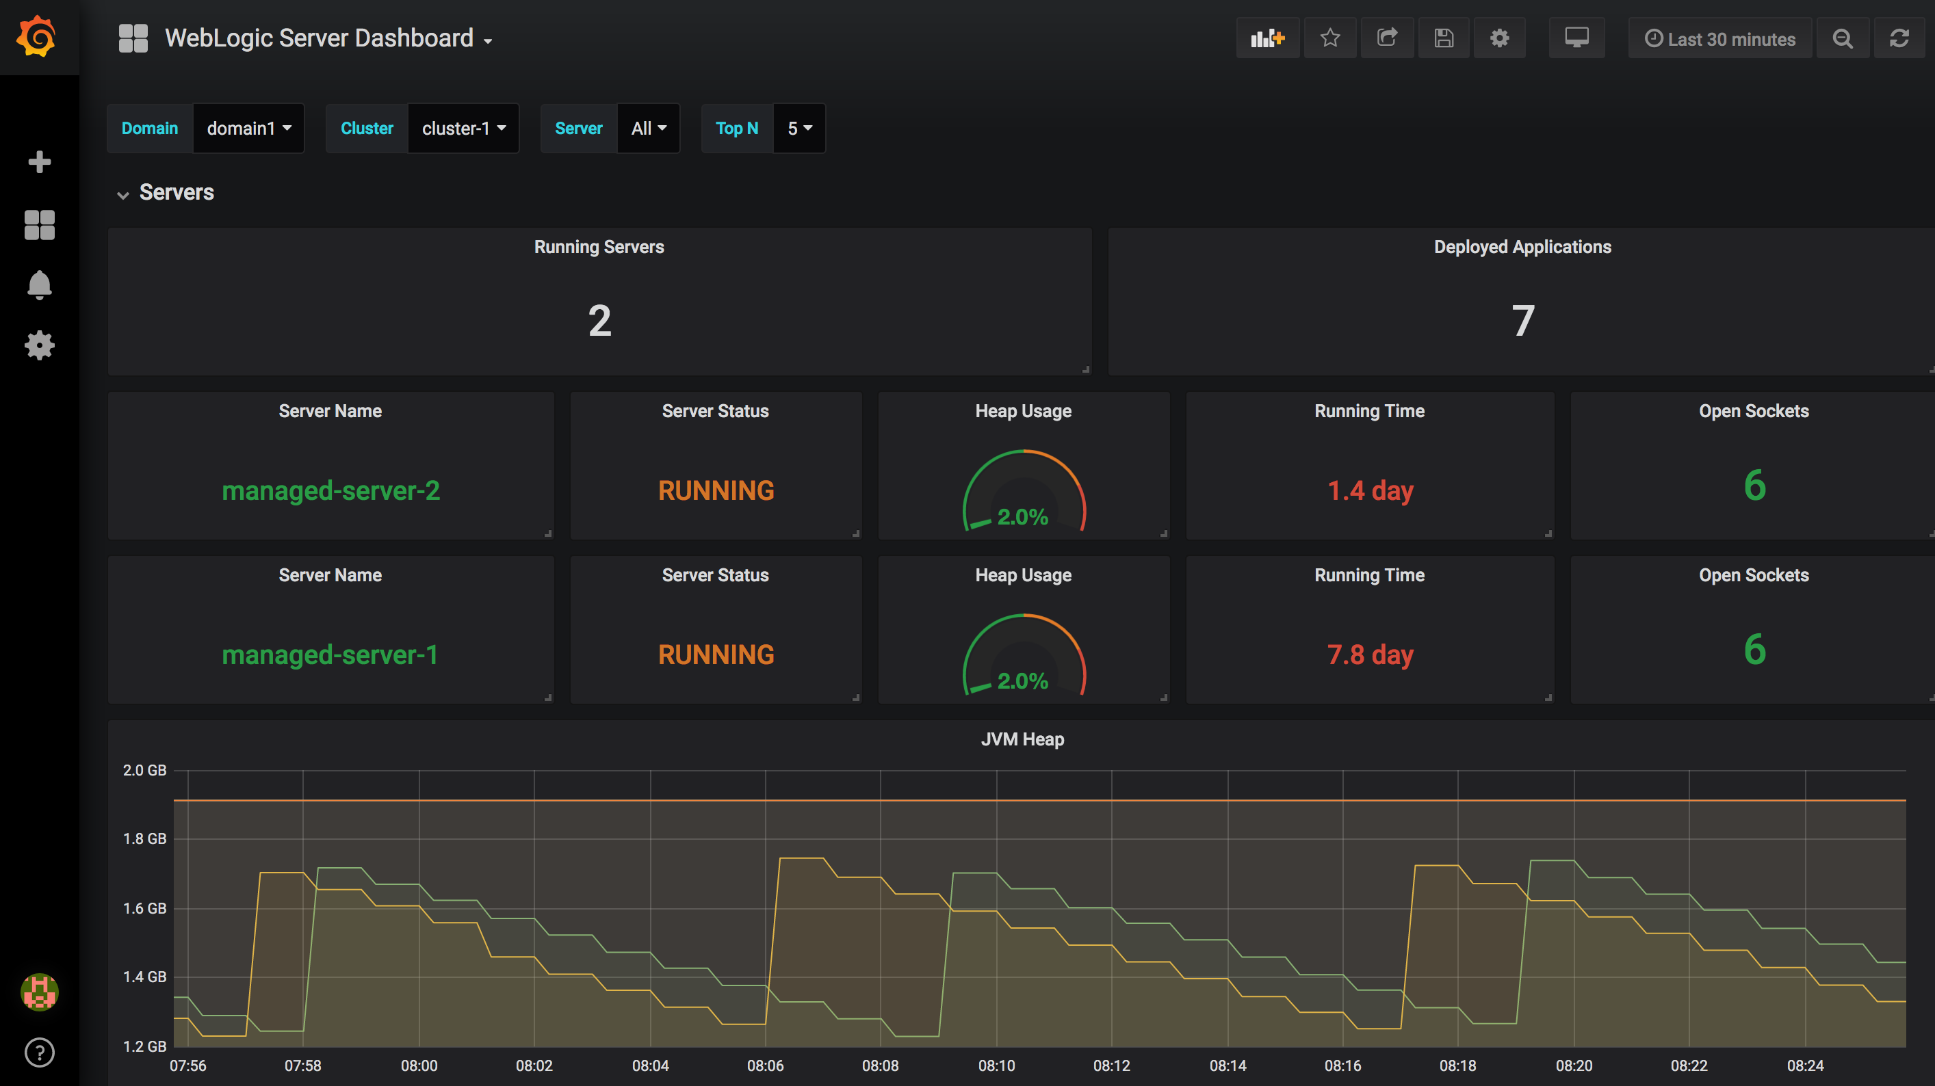

Automating WebLogic Deployment CI/CD with WebLogic Tooling
Repository
WebLogic domain
image
App v2
WebLogic domain v2
image
WDT model
Pull image
Push Image
Domain CR
Image Tool & WDT
Operator
Trigger: checkin
Domain.yaml
Roll the domain
Kubectl apply –f domain.yaml
WebLogic Domain
Step1: Update domain image
Step2: Update domain.yaml with new image name
WLS Cluster
POD 1
POD 2
POD 3
MS
Step3: Update Domain CR
MS
MS
AS
MS
MS
GitLab, Jenkins, etc.
Kubernetes Cluster

Slide 41
Automating WebLogic Deployment CI/CD with WebLogic Tooling
Repository
WebLogic binary
image
My Oracle Support
WebLogic domain
image
Invoke Patching
Pull image
Download patches
Pull image
WebLogic
Patched domain image
Push Image
Domain CR
Image Tool
Operator
Trigger: call to patch
Domain.yaml
Roll the domain
Kubectl apply –f domain.yaml
WebLogic Domain
Step1: Create/Update apply patch and update JDK
Step2: Update domain.yaml with new image name
WLS Cluster
POD 1
POD 2
POD 3
MS
Step3: Update Domain CR
MS
MS
AS
MS
MS
GitLab, Jenkins, etc.
Kubernetes Cluster

Slide 42
WebLogic on Oracle Container Engine for Kubernetes 練習簡介
開放權限 (OKE & Cloud Shell)
建立OKE Cluster
設定工具 (kubectl) 使用環境
將使用者放入OKE cluster中；建立存取權限
準備環境 (helm) 並將其加入存取權限中
建立環境以供給 WebLogic Operator 使用；namespace & service account
安裝 Load Balancer (Traefik Ingress)
設定 WebLogic Server 環境及部署 WLS Server並與 Operator & LB 連結
Scaling Up/Down、複寫 JDBC 連線、程式過版部署並指定伺服器
Notes:
https://github.com/kwanwan/weblogic-operator-tutorial/blob/CloudShell/tutorials/domain.home.in.image_short.md

Slide 43
Hands on Lab URL:
https://bit.ly/2wNfXU8
Notes:
https://github.com/kwanwan/weblogic-operator-tutorial/blob/CloudShell/tutorials/domain.home.in.image_short.md

Slide 44
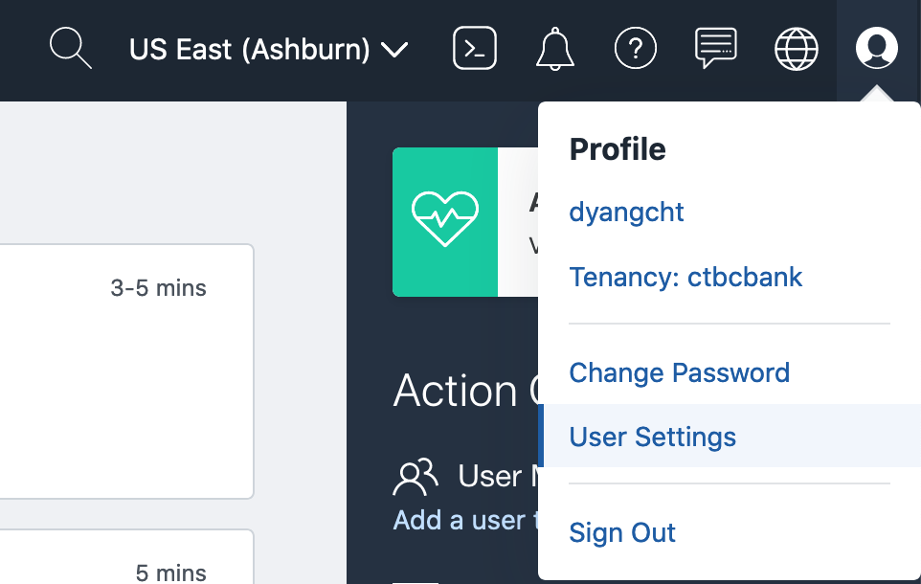
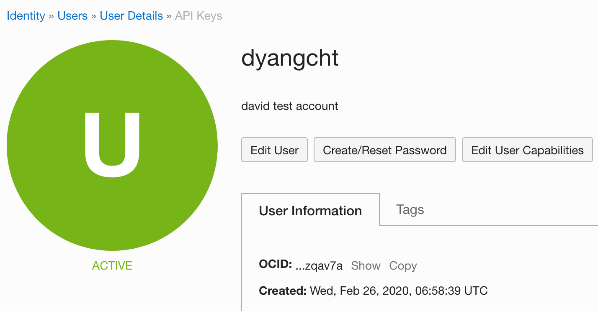
取得 OCI User OCID – Lab2

Slide 45
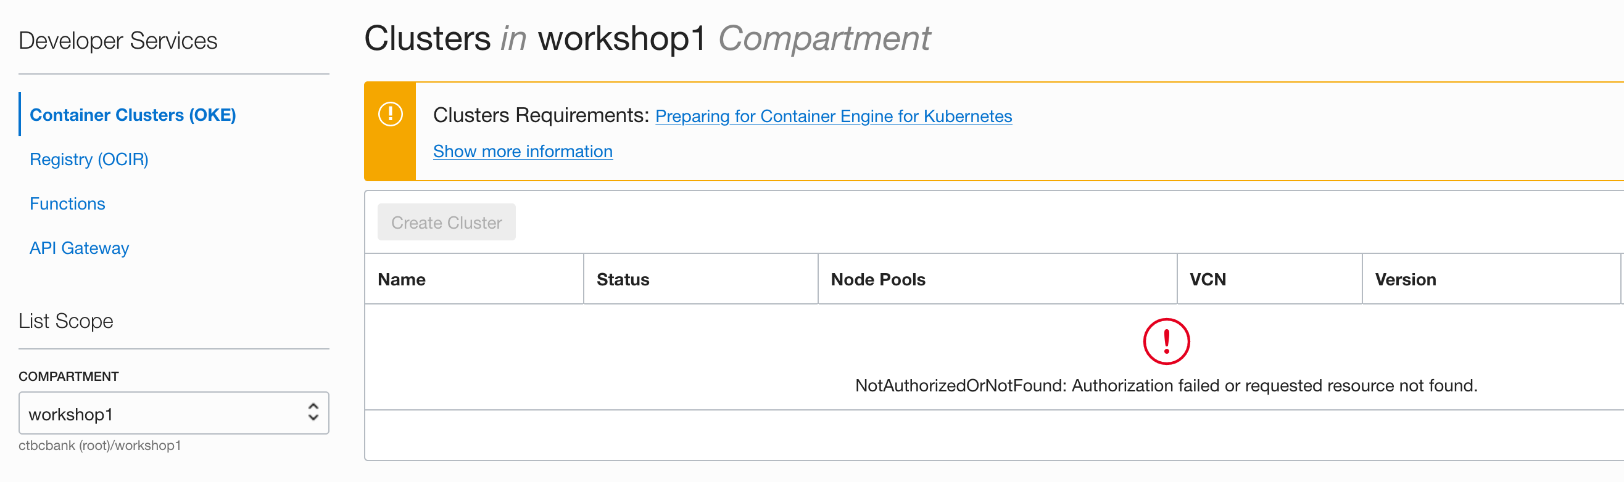
Authorization failed – 錯誤的 COMPARTMENT

Slide 46
Thank You

Slide 47
Workshop
Lab Content
http://bit.ly/wls-k8s-hol-short

